Slide 1
NODE.JS
(The Backend Of MERN Stack)
Lecture 25

Slide 2
Today’s Agenda
Connecting Node To MySQL
Steps Required
Getting Connection Object
Opening The Connection
Executing The Query
Exercises
Closing The Connection

Slide 3
Connecting node to mysql
In order to connect a Node application to MySQL we need to follow below mentioned steps:
Install the mysql driver.
Import mysql in the code to get back an object.
Establish the connection to MySQL database.
Execute the SQL query and handle the response.

Slide 4

Step 0-Installing mysql package
The first step in connecting to MySQL is to install an npm package called mysql .
This package provides all the necessary methods and objects which are required to access MySQL from a Node application.

Slide 5
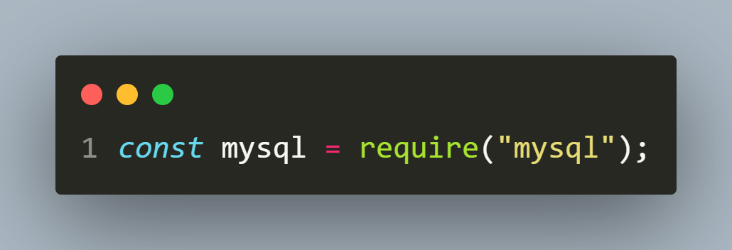
Step 1- import mysql
The next step is to load the mysql package using the require() function.
The above call will return an object which provides methods to interact with MySQL database.

Slide 6
Step 2- establish the connection
The next step is to connect our application to the MySQL database.
This step itself has two sub-steps:
Get a connection object.
Open the connection to the database

Slide 7
Step 2a- get the connection object
A connection object can be created through the createConnection() method of the mysql instance.
This object can then be used to create a connection between the server and the client.
It accepts an object with 4 key-value pairs as shown in the next slide:

Slide 8
Step 2a- get the connection object
host - The ip/computer name of the computer where MySQL server is running. The default value is 'localhost’.
user - The database username . The default value is 'root’.
password - The database password. The default value is an empty string (no password).
database – The name of the database with which we want to connect.

Slide 9
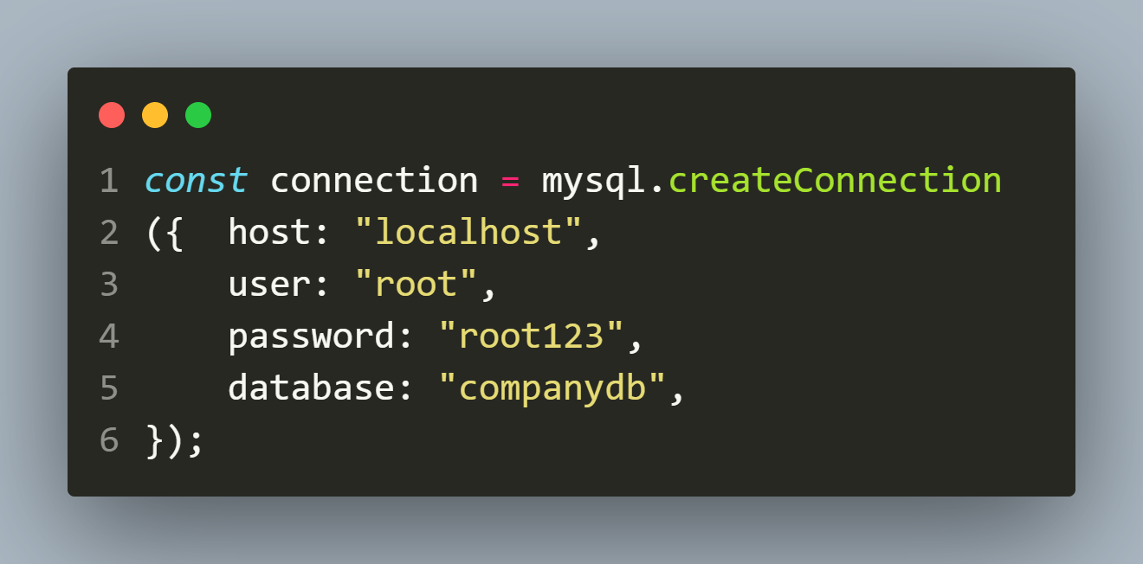
example

Slide 10
Step 2b- opening the connection
Once a connection has been configured, we can establish a connection to the server.
To do this we call the connect() method of connection object.

Slide 11
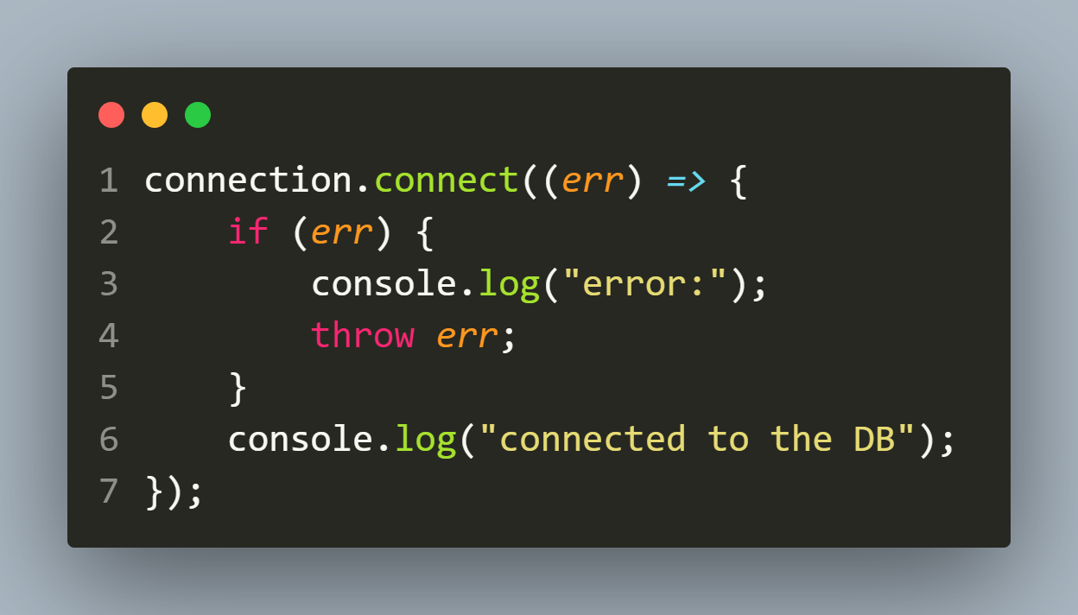
Step 2b- opening the connection
The connect() method works asynchronously and uses a callback which allows us to check whether the connection was successful or not.

Slide 12
Exercise 56
Write an Expresss-EJS application to connect to the MySQL database and display the message connected successfully to the database if connection is successful or display the error in case of any exception.
Following are the details of the connection:
Component | Value
host | localhost
user | root
password | root123
database | companydb

Slide 13
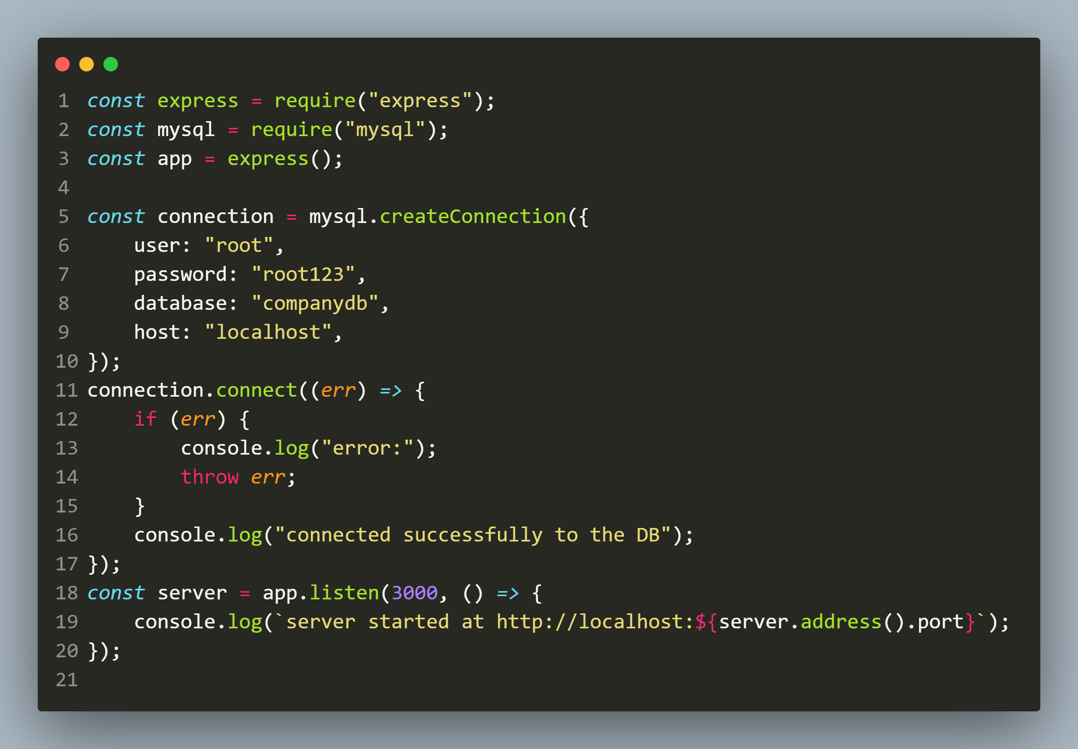
solution

Slide 14
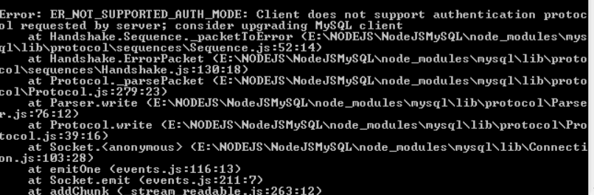
An important point!
It's quite possible that when you run the previous example, probably, you will receive a error notice as follows:

Slide 15
Why this error occurred ?
The cause of above error is that we are using too new MySQL database (version >= 8.x) which uses a different authentication plugin (SHA256_PASSWORD).
But NodeJS MySQL library hasn't changed yet and It still uses the old authentication plugin (SHA2_PASSWORD).

Slide 16
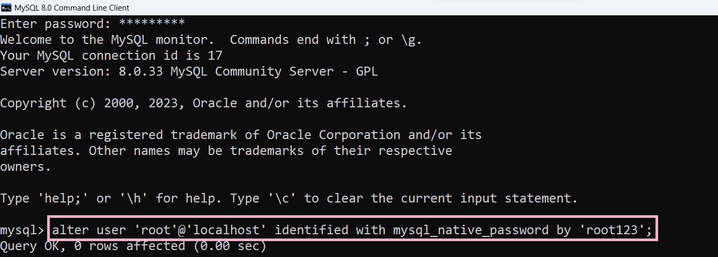
solution
As a solution to this we need to execute the following command in MySQL Command Line Client:

Slide 17
Step 3- execute the query
Almost all of the actions we need to perform in a MySQL database are done through SQL queries.
To send an SQL query to MySQL database we call the method query() of the connection object.

Slide 18
Step 3- execute the query
It accepts a string, representing a query we'd like to send to the database.
A query may fail or return some result.
Thus query() accepts a callback with 2 arguments preferably called err and result based on how the operation went.

Slide 19
What does result hold ?
The variable result will hold the response depending on the type of query we sent for execution:
If it is a SELECT query , it holds an array of objects of type RowDataPacket which is a low level library of mysql package.
For all other queries it holds a simple JS object with some key value pairs which includes details about how the query affected the table.

Slide 20
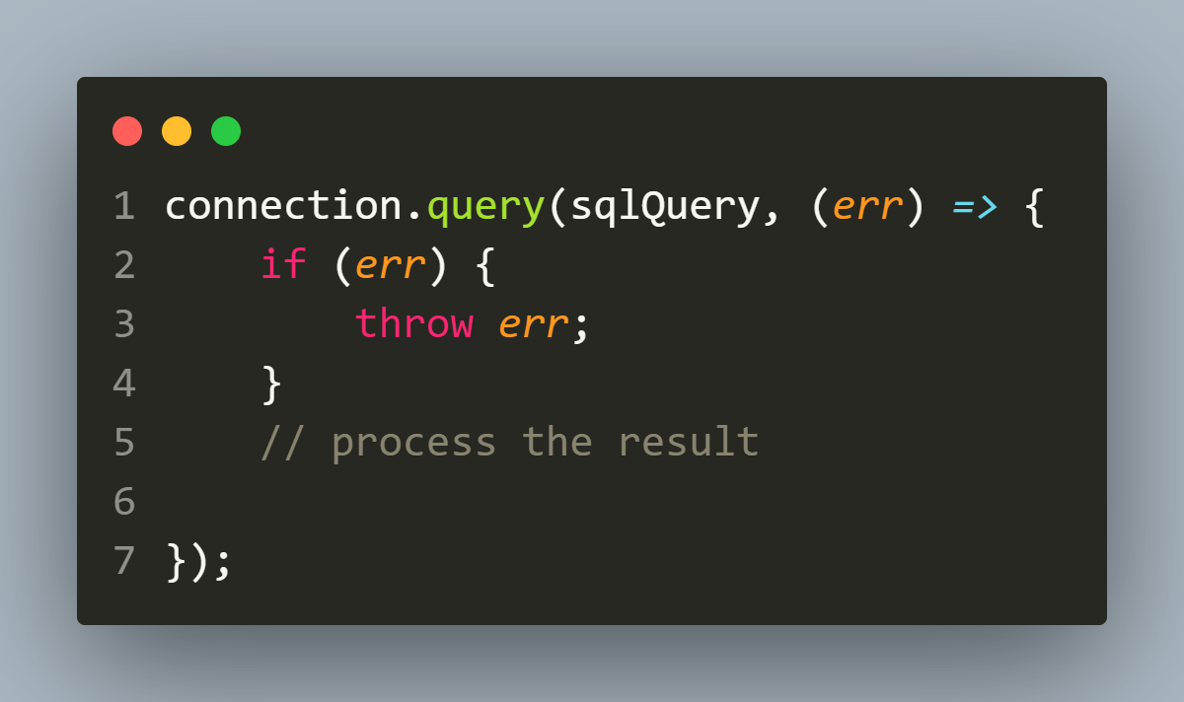
example

Slide 21
Exercise 57
Write an Expresss-EJS application to connect to the MySQL database and fetch and display all the records from EMP table.
Following are the details of the database/table:
Component | Value
host | localhost
user | root
password | root123
database | companydb
table | EMP
columns | empid,ename,sal

Slide 22
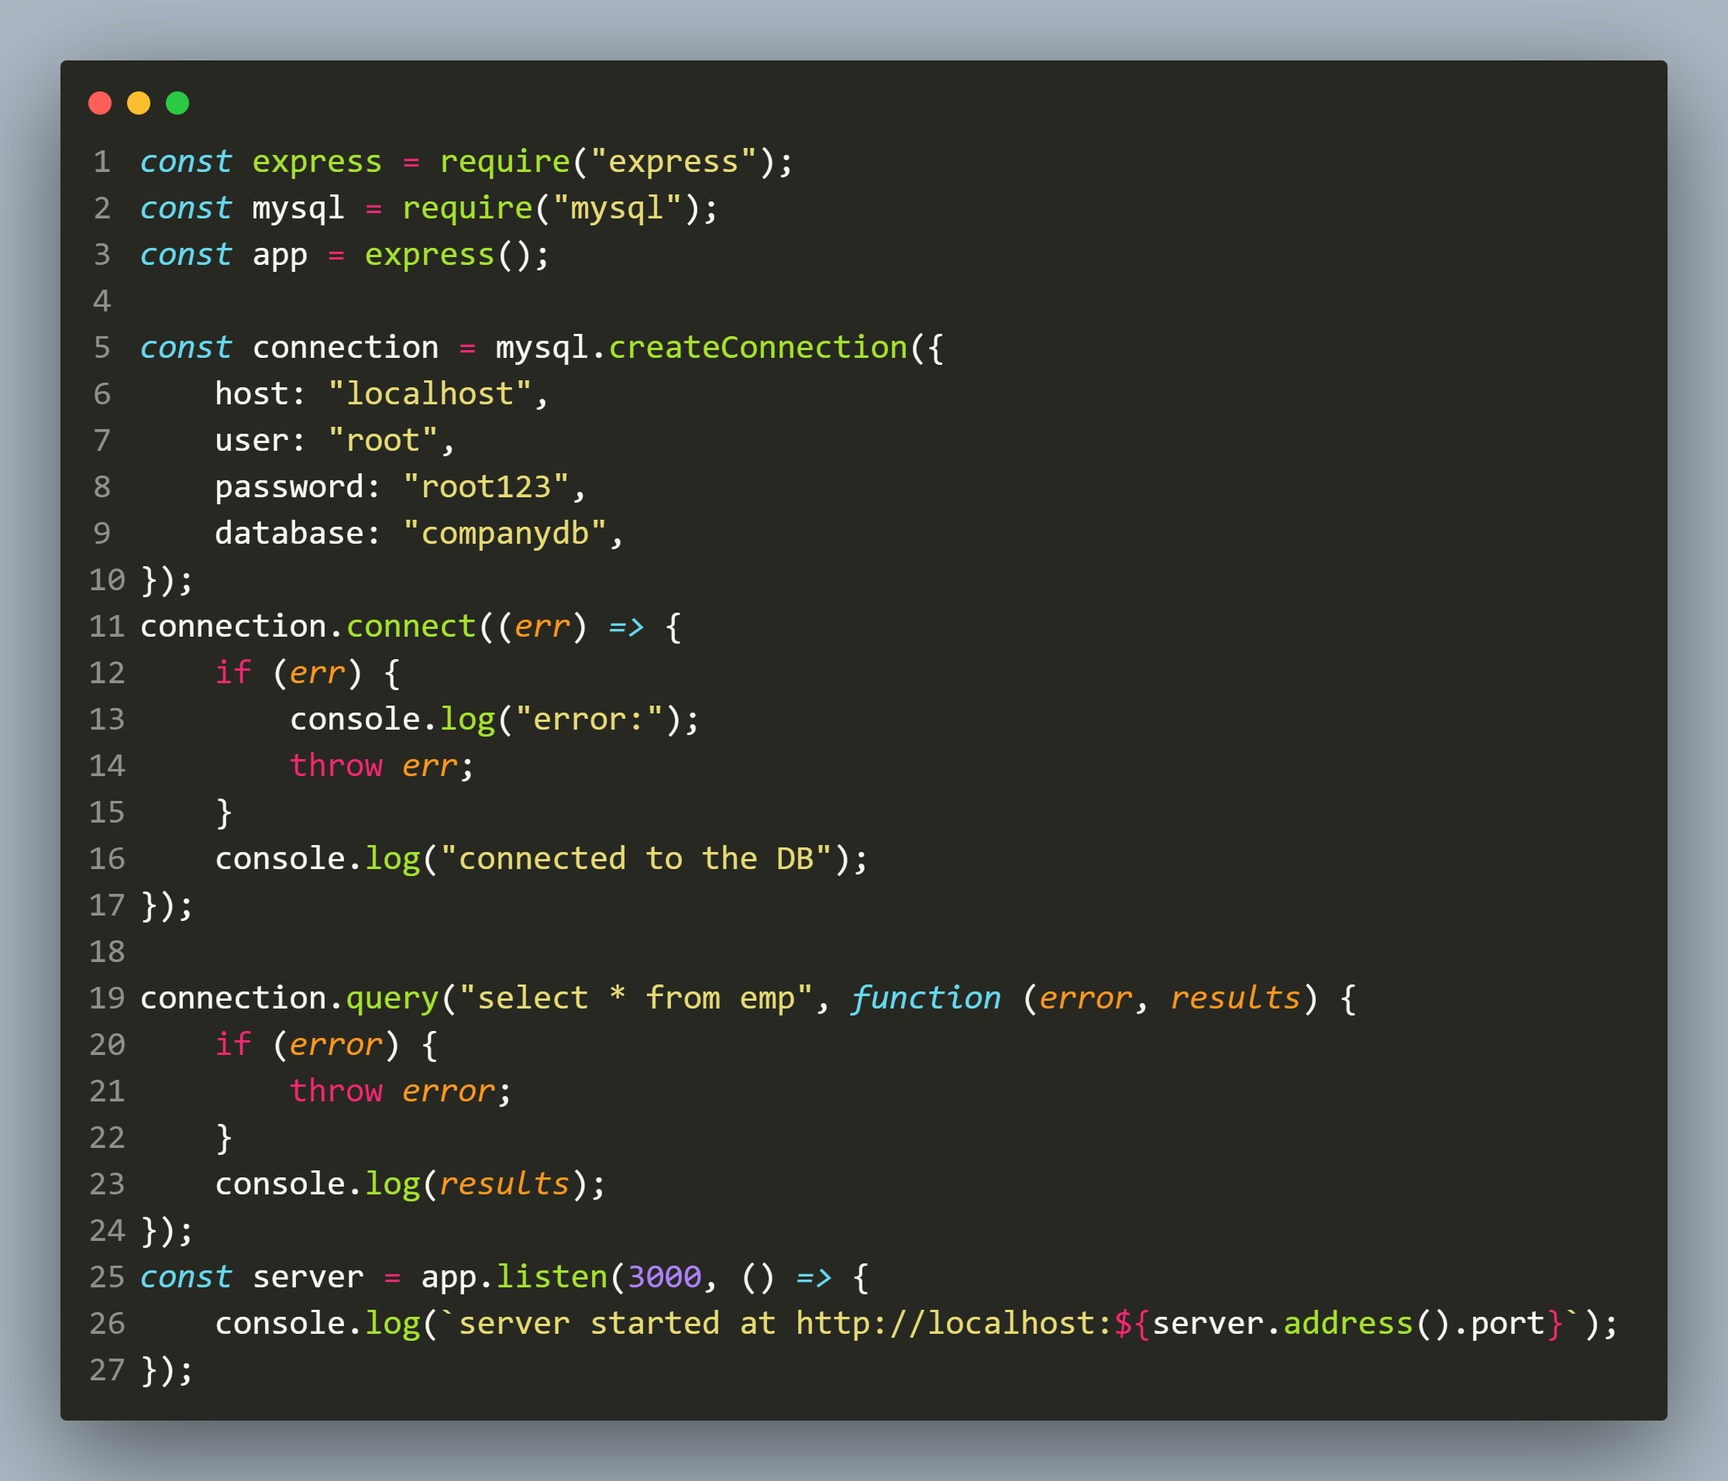
solution

Slide 23
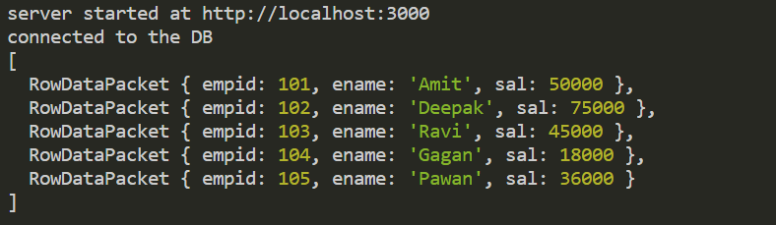
output

Slide 24
Exercise 58
Modify the previous app so that now your code displays total number of records fetched from the database as well as each record individually in one row.

Slide 25
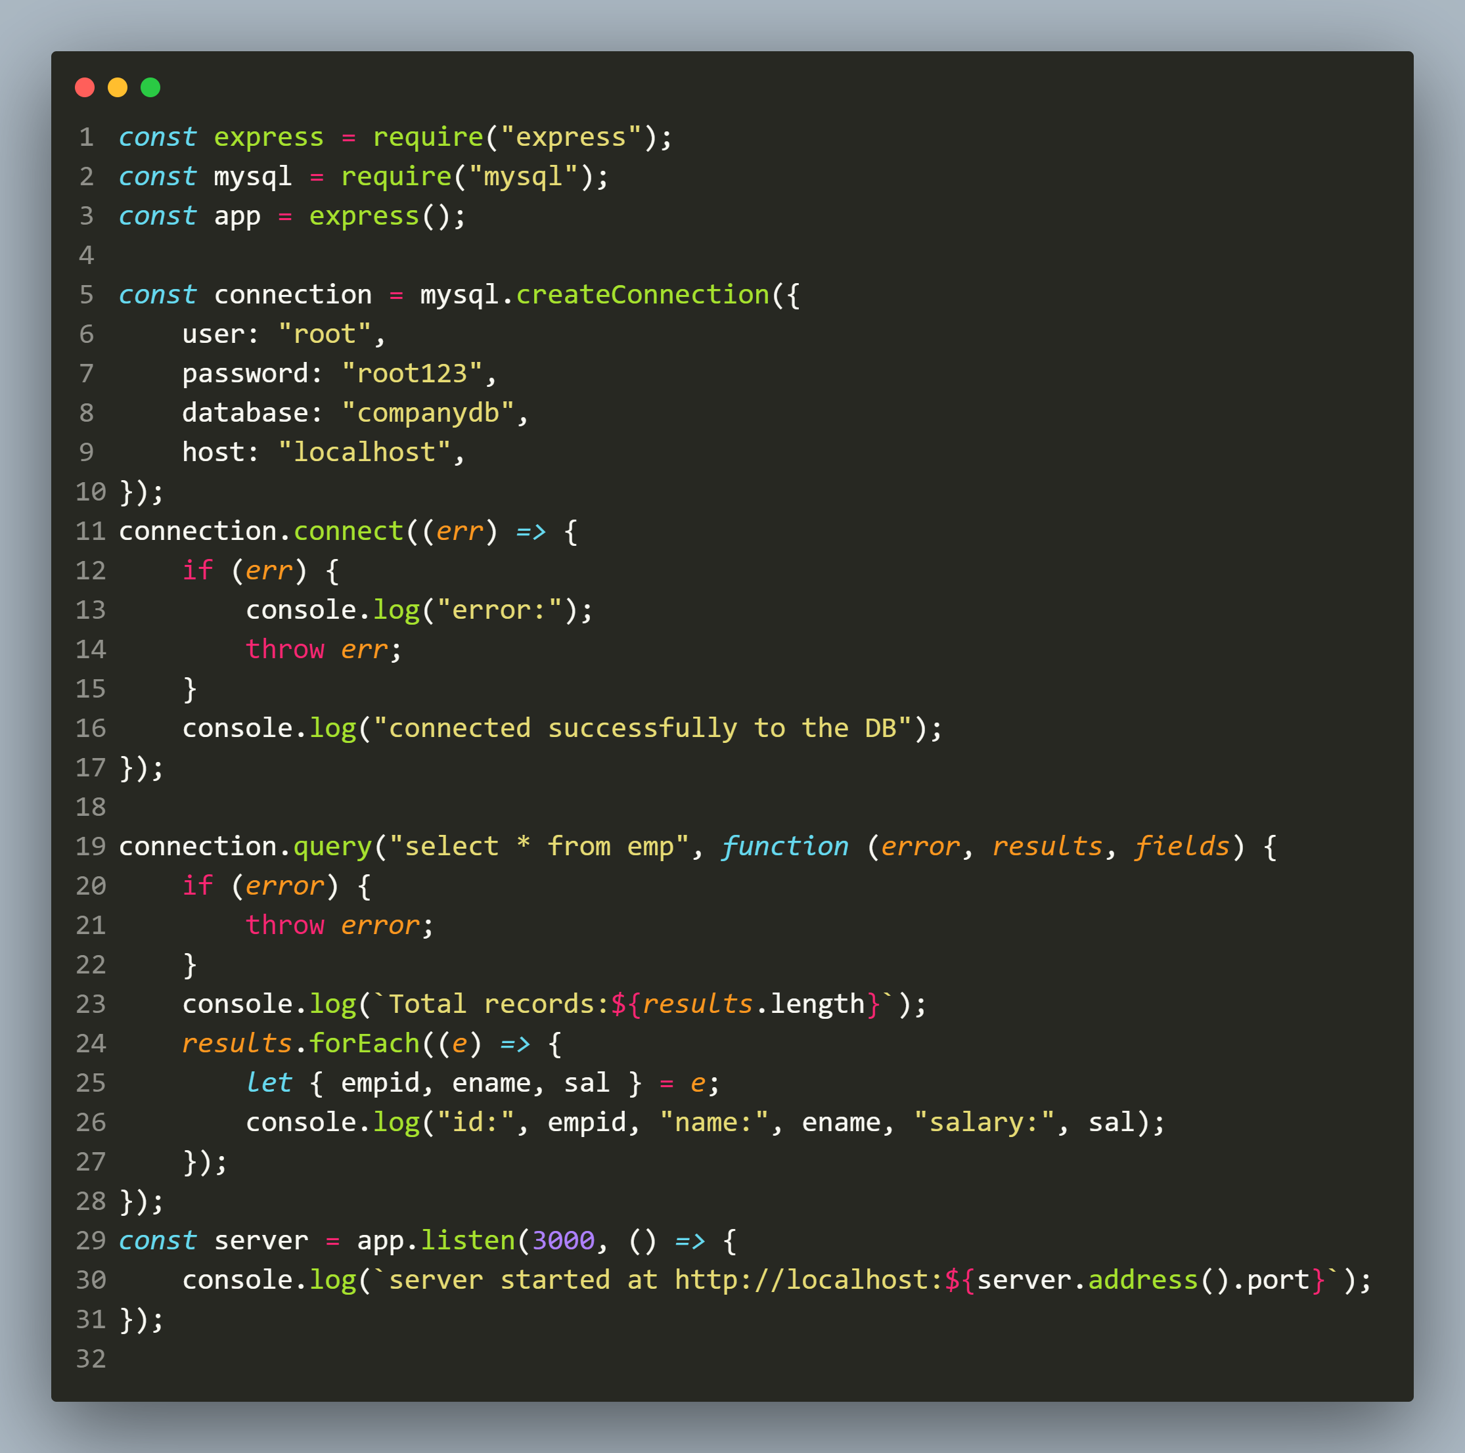
solution

Slide 26
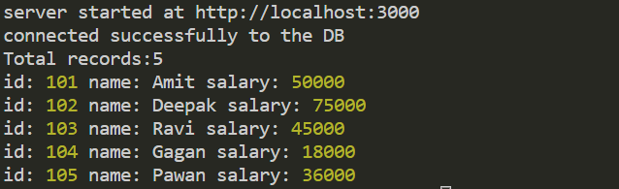
output

Slide 27
Exercise 59
Write an Expresss-EJS application to handle the api call GET : /api/employees and return total number of employees as well as records of all the employees as JSON objects.
In case of any exception during query processing return the error code 500 with the DB error message.

Slide 28
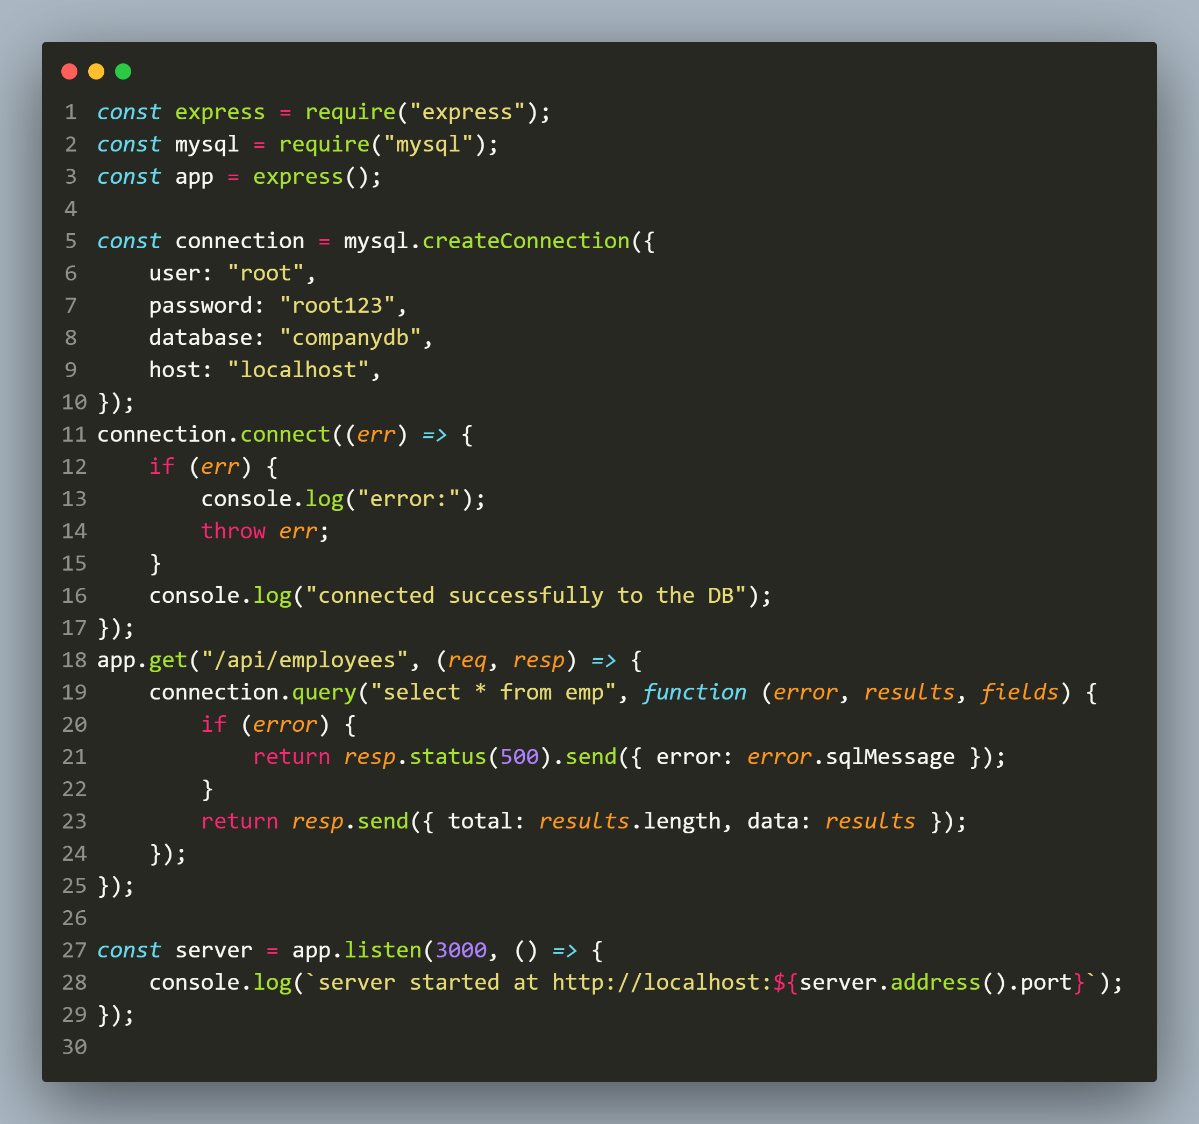
solution

Slide 29
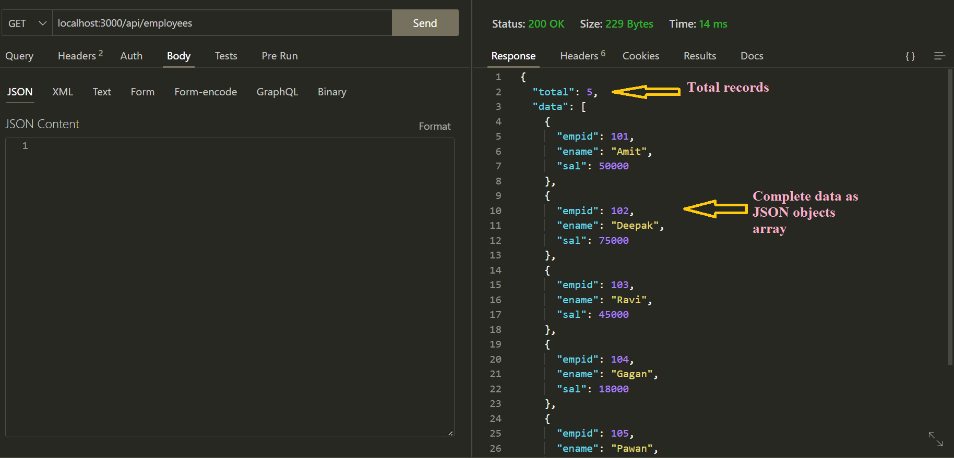
output

Slide 30
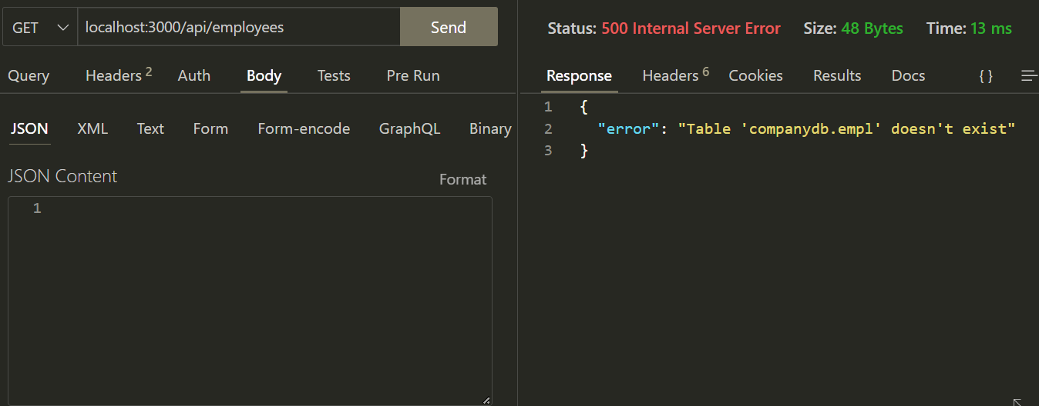
In case of wrong query

Slide 31
Exercise 60
Modify the previous code so that now your app returns an HTML response to the user containing total records and every record displayed as a row in an HTML table to the client.
In case of any exception during query processing return the error code 500 with the DB error message.

Slide 32
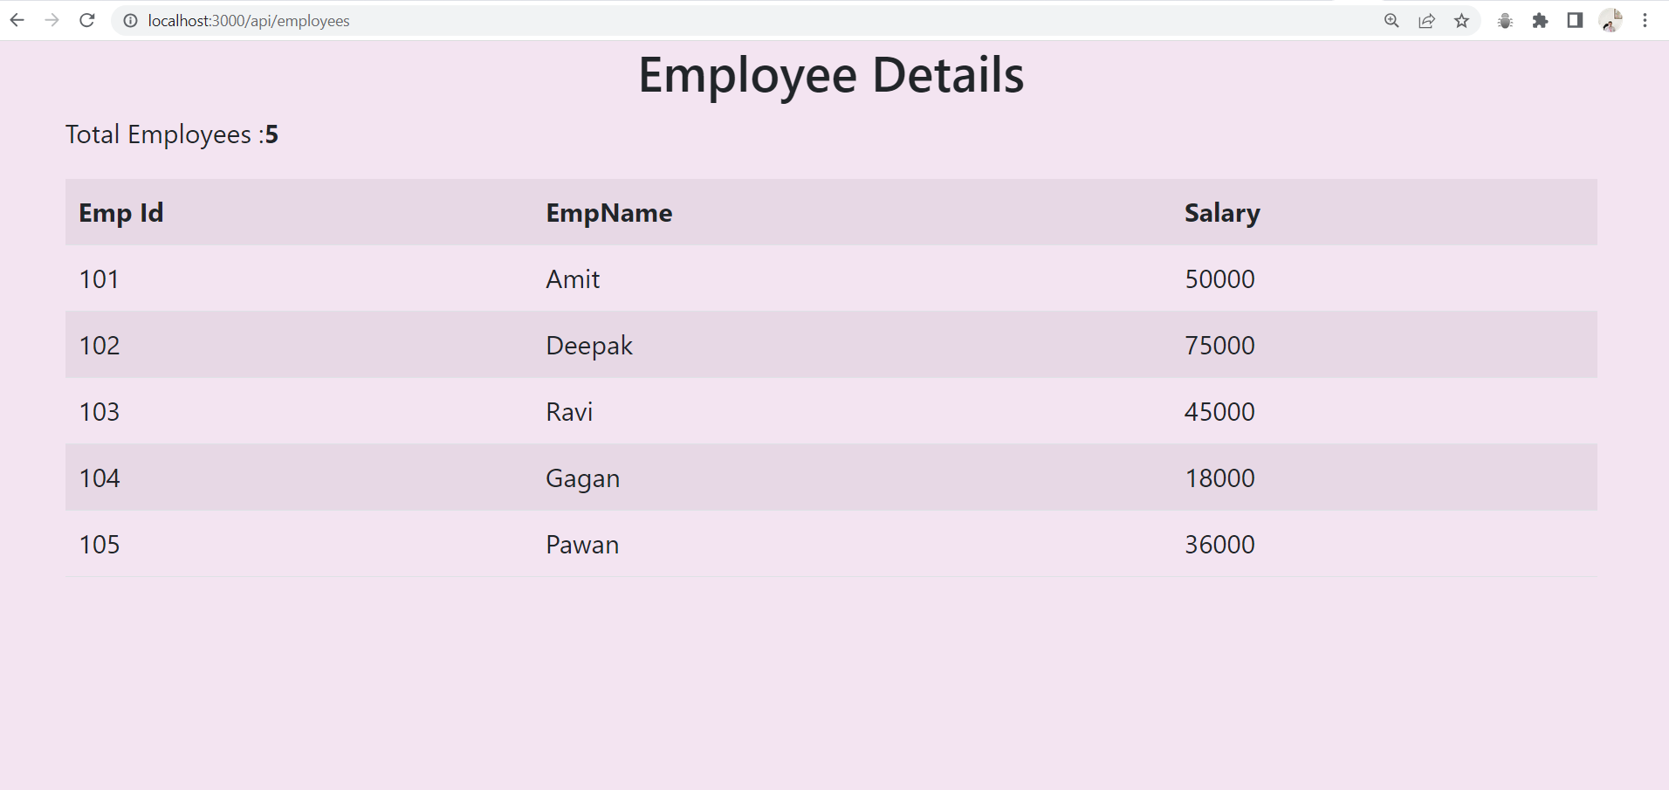
output

Slide 33
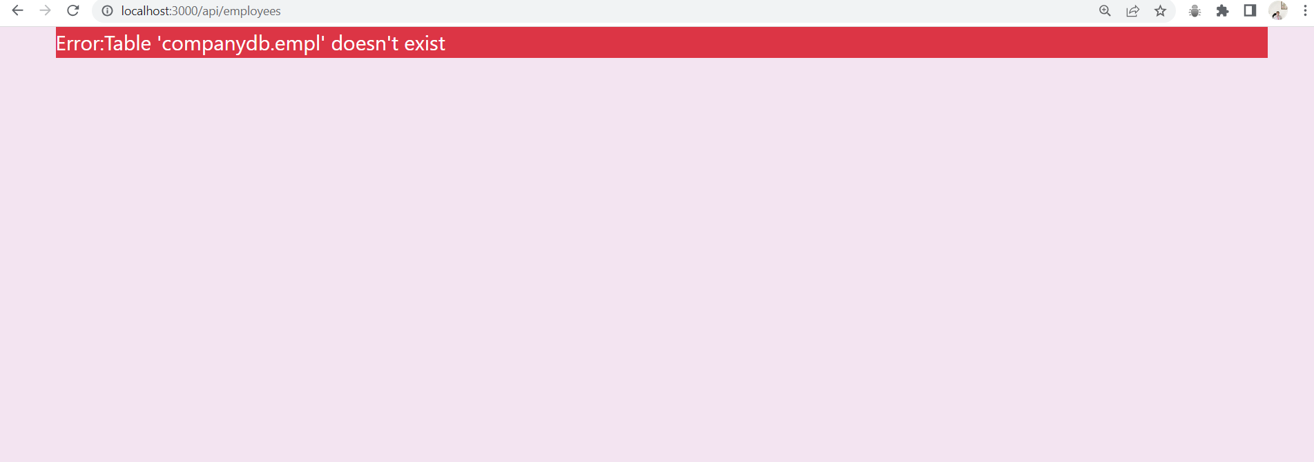
In case of wrong query

Slide 34
Closing the connection
To close a database connection, we can call the end() method on the connection object.
The end() method ensures that all remaining queries are always executed before the database connection is closed.

Slide 35
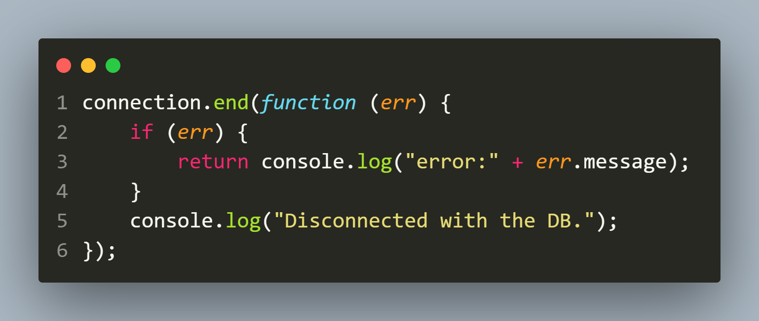
Closing the connection

Slide 36

Another way
To force the connection to close immediately, we can use the destroy() method.
The destroy() method guarantees that no more callbacks or events will be triggered for the connection nor it takes any callback as argument.

